Slide 1

Demo CubeMX-AI:
A CIFAR10 classification
Alessio Burrello,
alessio.burrello@unibo.it
Credits: Marcello Zanghieri,
Enrico Tabanelli

Slide 2
Summary
Creation of the python model and production of the saved model (.h5)
Creation of the CubeMX project and validation on NUCLEO-H743ZI
Creation of the application for network inference
Application: sending images from PC through serial communication, and classifying them on the board.

Slide 3
Summary
Creation of the python network and production of the saved model (.h5)
Creation of the CubeMX project and validation on NUCLEO-H743ZI
Creation of the application for network inference
Application: sending images from PC through serial communication, and classifying them on the board.

Slide 4
Python network generation: keras
Dependencies
Keras
Tensorflow
Running Keras CIFAR10 network example

Slide 5
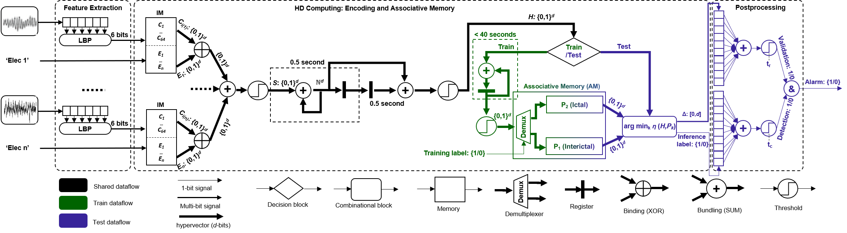
Epilepsy detection on short/long recordings
LBP symbol
iM_C
Hypervectors
Bundling
Bundling
‘110011’
‘0010…10101’ ϵ {0,1}^{d}
‘1111…11111’ ϵ {0,1}^{d}
H
‘1010…10001’ ϵ {0,1}^{d}
‘1010…100101 ϵ {0,1}^{d}
‘0000…11111’ ϵ {0,1}^{d}
‘1011…10010’ ϵ {0,1}^{d}
‘1011…10010’ ϵ {0,1}^{d}
iM_E
‘1010…10101’ ϵ {0,1}^{d}
‘1101…01100’ ϵ {0,1}^{d}
‘1011…01111’ ϵ {0,1}^{d}
Elec ‘1’
‘1000…11011’ ϵ {0,1}^{d}
Associative memory for both training and testing
Few shot learning. No Back-propagation or iterative learning.

Slide 6
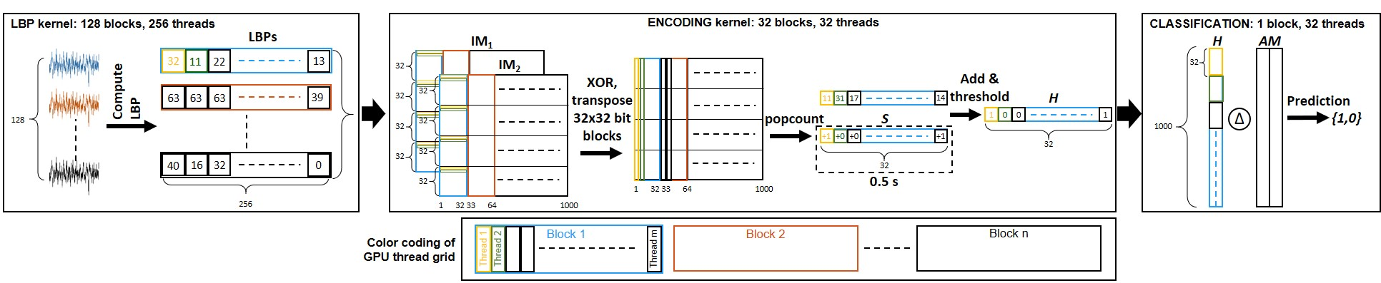
Epilepsy detection on short/long recordings
128 Electrodes
128 Electrodes
487x
464x
16x
16x
Energy [mJ]
2.9x
Time [ms]
3.9x
1x
1x

Slide 7
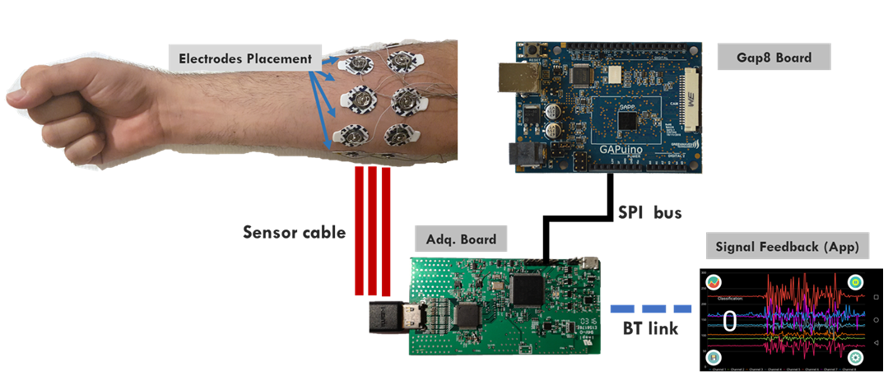
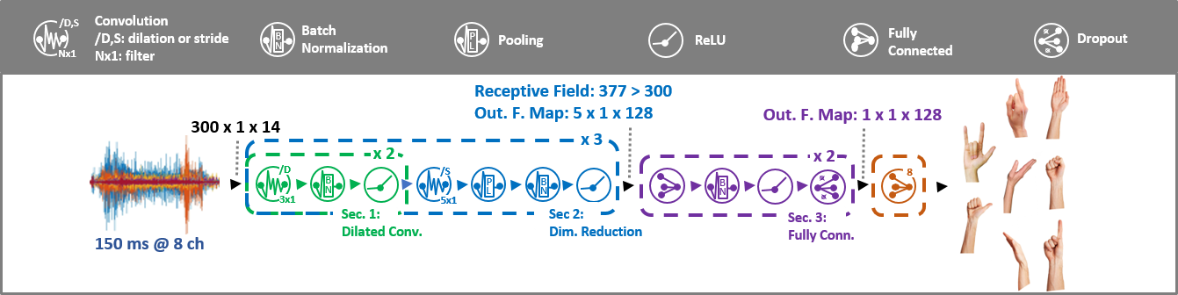
TCN based gesture recognition
TEMPOnet
Temporal Embedded Muscular Processing Online Network
3 conv layers (2 dilated + 1 strided)
2 Fully connected
9 classes output

Slide 8
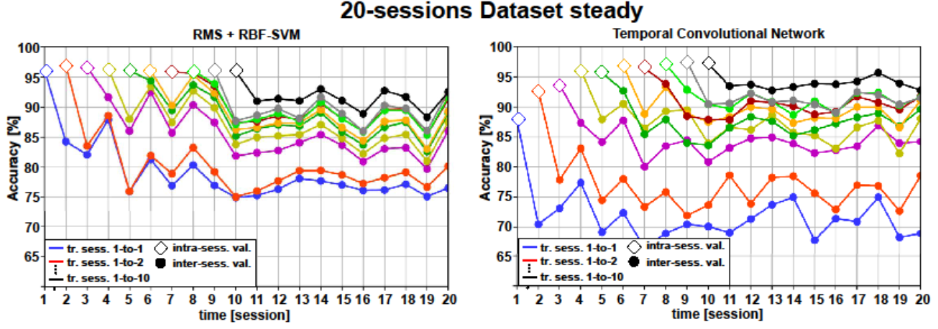
TCN based gesture recognition

Slide 9

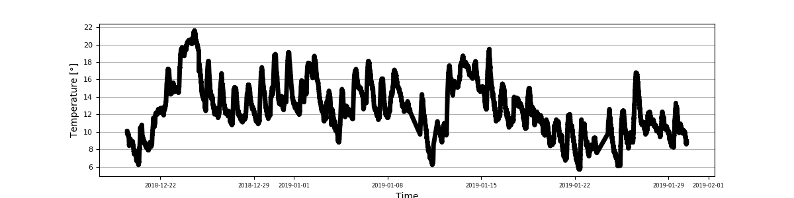

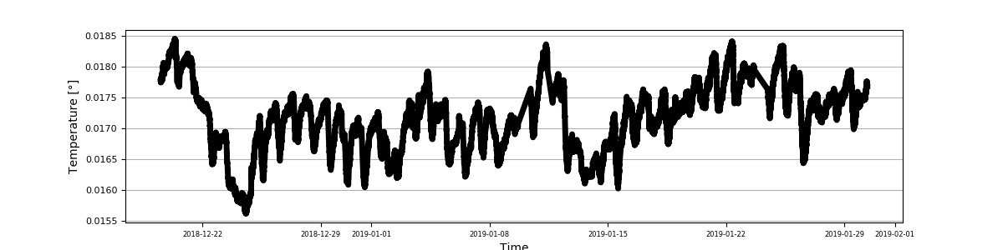
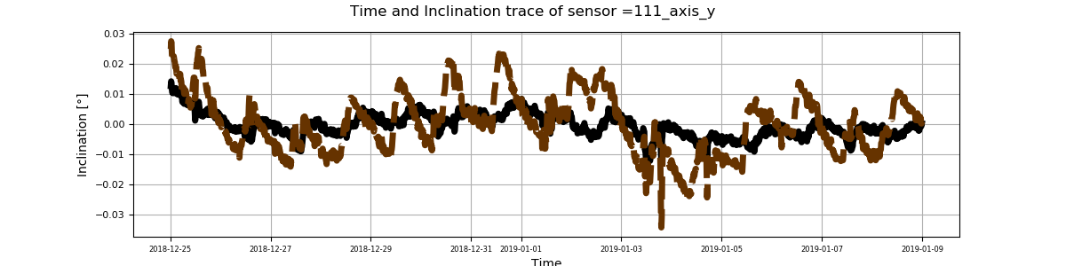


Thermal Removal
Cloud processing
1) Data calibration
2) Temperature compensation
3) Thresholds verification
4) Alarms
Edge processing
1) Data collection
2) Data transmission
Accelerations/Temperatures
Instrumented viaduct
storage
4G communication
Inclinations
1 time x week: MLP fine-tuning
Model
tuned
Gateway
Accelerations / Temperatures
Alarm (e.g. mail)
1 time x day: Temp. compensation
storage
Maintainer
3-axial MEMS
accelerometer
Th 2
Alarms
Node
Th 1
Temperature
sensor
Two phases
Calibration of the algorithm → 1 x week
Temperature compensation → 1 x day

Slide 10
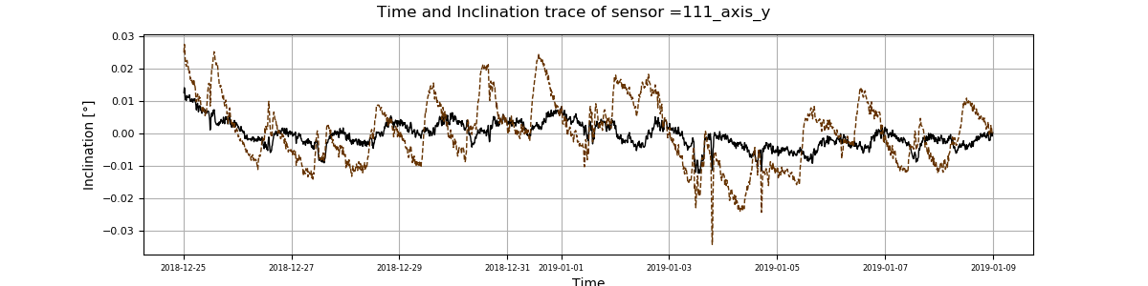
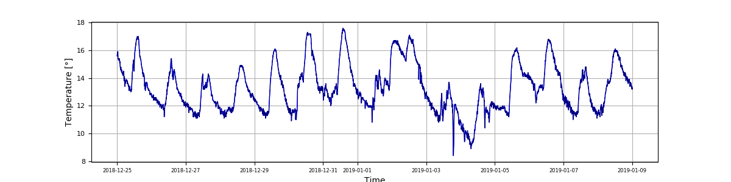

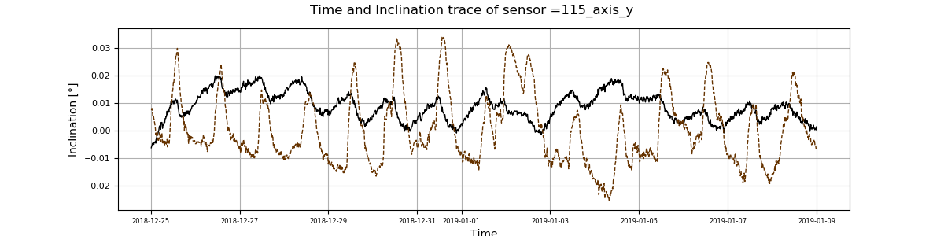
Thermal Removal
0.02
0
-0.02
Sensor 1
Inclination [°]
Raw data
Cleaned data
16°
12°
8°
Temperature [°]
Sensor 5
0.02
0
-0.02
Inclination [°]
25-12 27-12 29-12 31-12 02-01 04-01 06-01 08-01
Time [day]

Slide 11


Network traffic reduction via PCA based approach
Raw data
No information loss
MEMS accelerometers
Cloud
No computing overhead
S1
S2
S3
Sn
GATEWAY
500 Kb/s
High bandwidth
PCA compression
GATEWAY
Lossy compression
MEMS accelerometers
Compressed data
Cloud
Training on Cloud for all the installations
S1
S2
S3
Sn
50 Kb/s
PCA reduction
PCA training
Conversion Matrix
Low bandwidth
Streaming PCA compression
Lossy compression
MEMS accelerometers
GATEWAY
Compressed data
Cloud
Training on board
S1
S2
S3
Sn
50 Kb/s
Low bandwidth
PCA training
PCA reduction

Slide 12
Network traffic reduction via PCA based approach
Testing
k: Principal components
d: Number of features
Store of the transformation matrix dxk
k
B: Block size
t₀
Low memory occupation
X
B
t₁
d
Training
N
Iteratively compute the transformation matrix dxk
Store the input blocks Bxd
.
.
.
N: Number of instances
Low memory occupation
B
t_{n}
B ϵ [1,N]

Slide 13
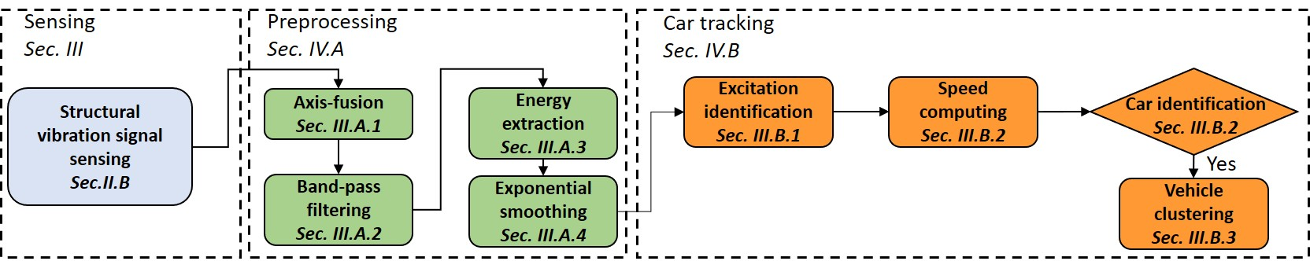
Vehicles identification and tracking
Accelerations extraction: 100 Hz sampling frequency
3-axis acceleration → univariate signal
Anomaly detection: Gaussian modeling
Speed computation: regression analysis
Vehicle identification: clustering

Slide 14
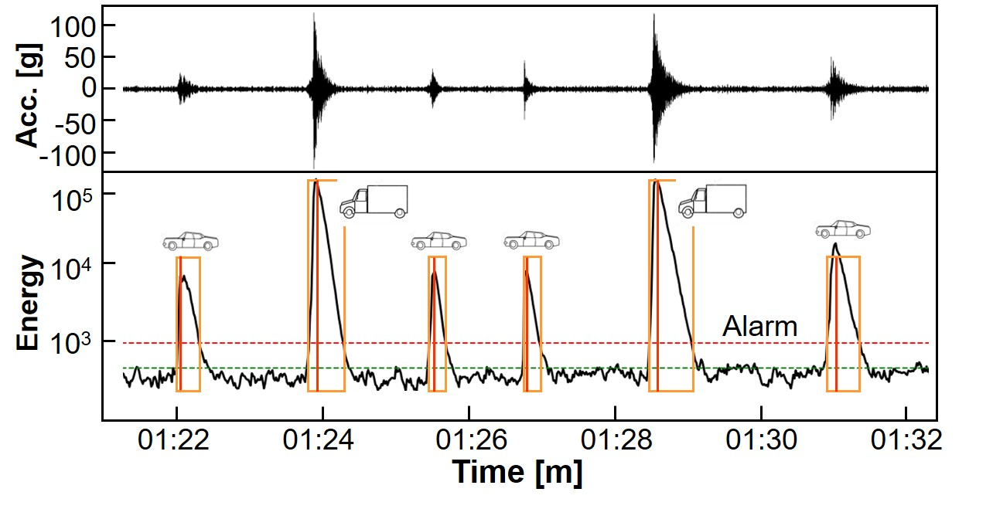
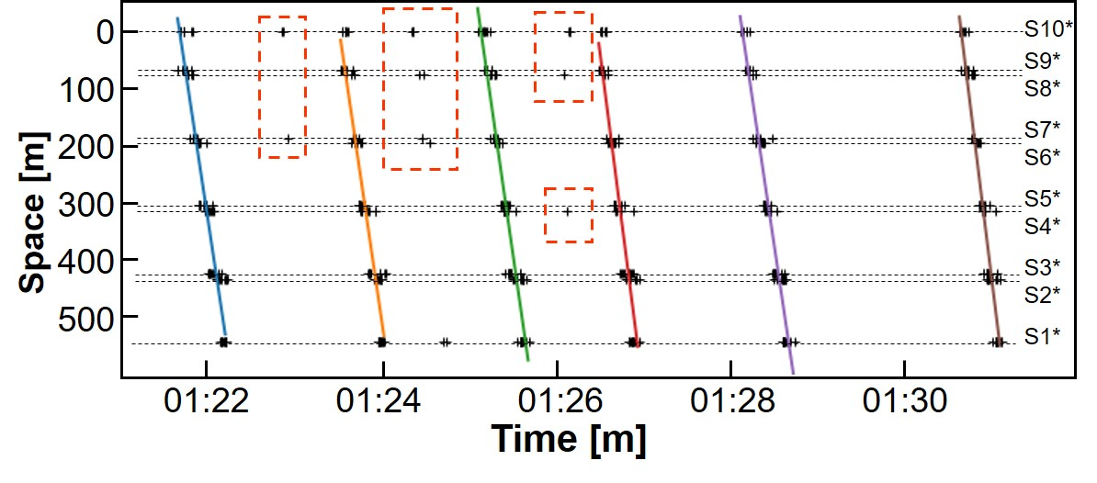
Vehicles identification and tracking
Energy extraction
Mean and standard deviation computing in a reference period without peaks
Energy > Mean+ 3*Std → anomaly (vehicle)
Anomalies linked to sensor position
Regression fitting
Removal of theoretical speeds > 150 km/h and < 30 km/h

Slide 15
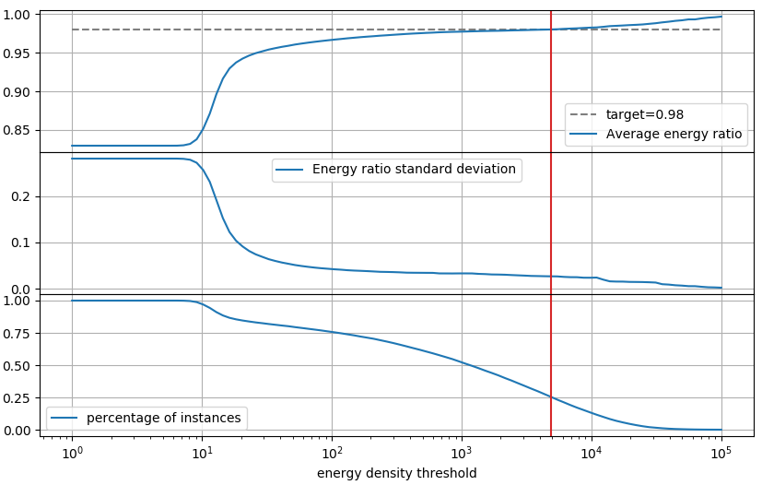
Anomaly detection
Energy fraction over a day as function of the threshold on instance energy
Average energy fraction (e.g. expected value is 0.98)
Variance of the
energy fraction
(the lower the better)
Fraction of
windows selected

Slide 16
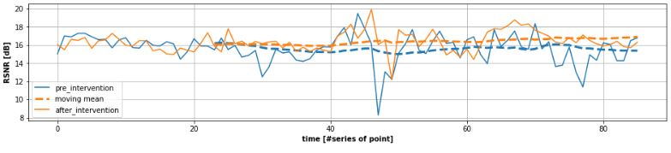
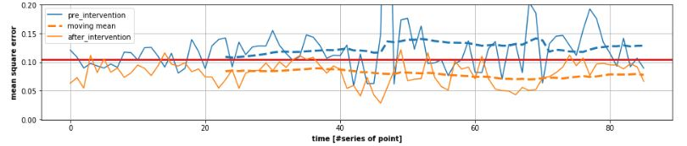
Anomaly detection
PCA solution
Autoencoder solution

Slide 17
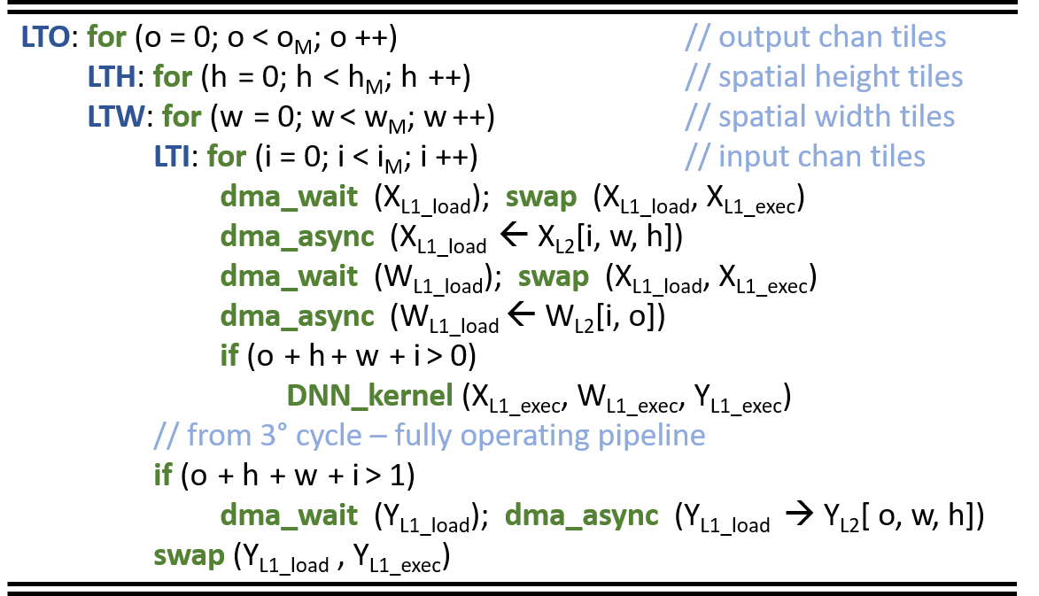
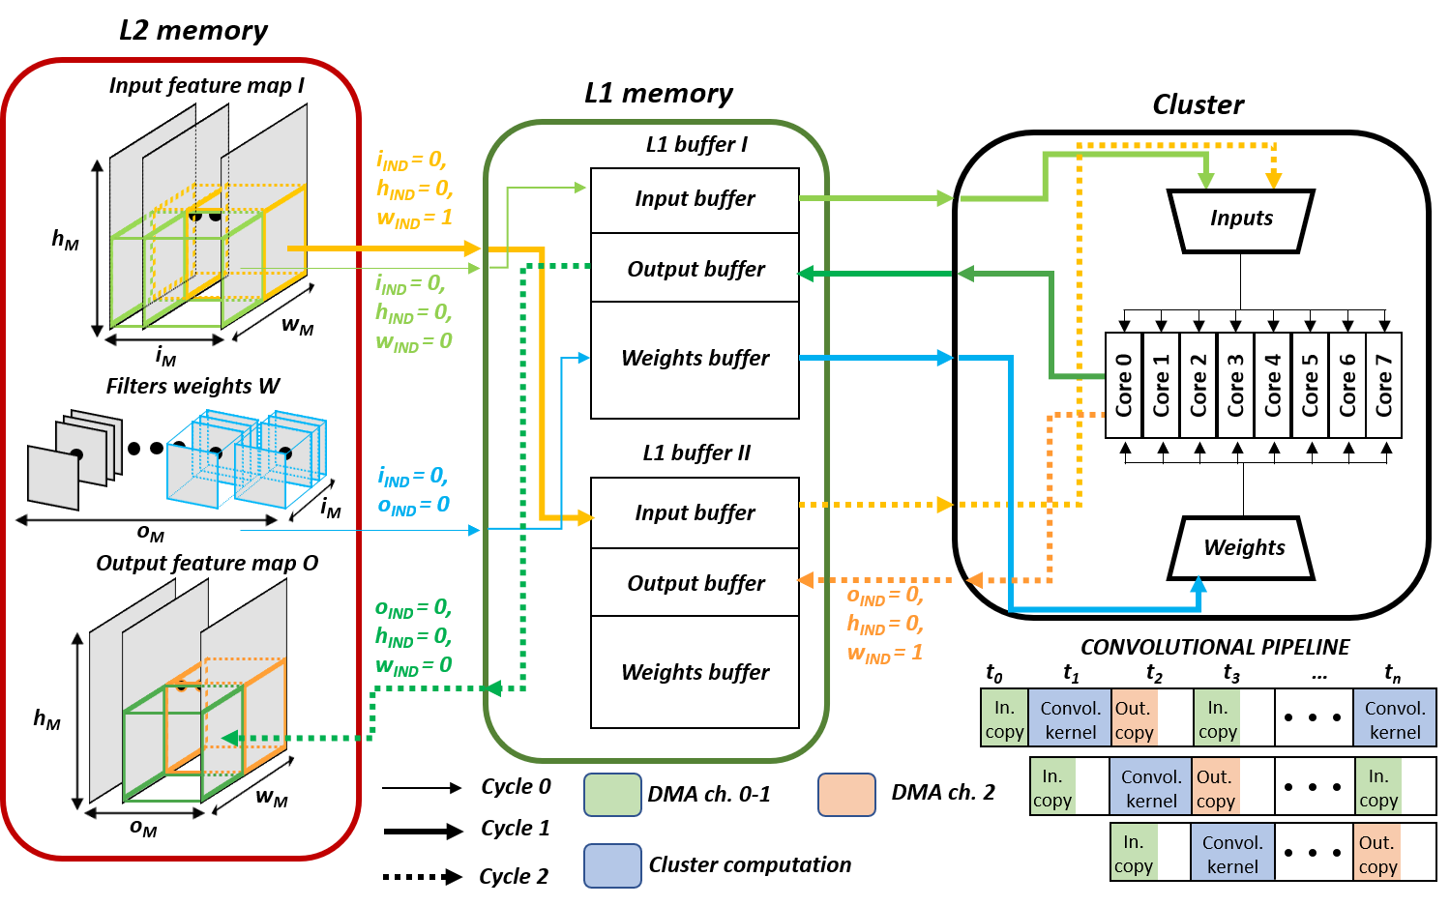
Dory: Deployment Oriented to memoRY
C generated layer function to manage the tiling with PULP-NN backend.
Version 1: layer-wise L1/L2 tiler based on Google ortools constraint solver.
Version 2 (in development): L3/L2 tiling. Network function generated.

Slide 18
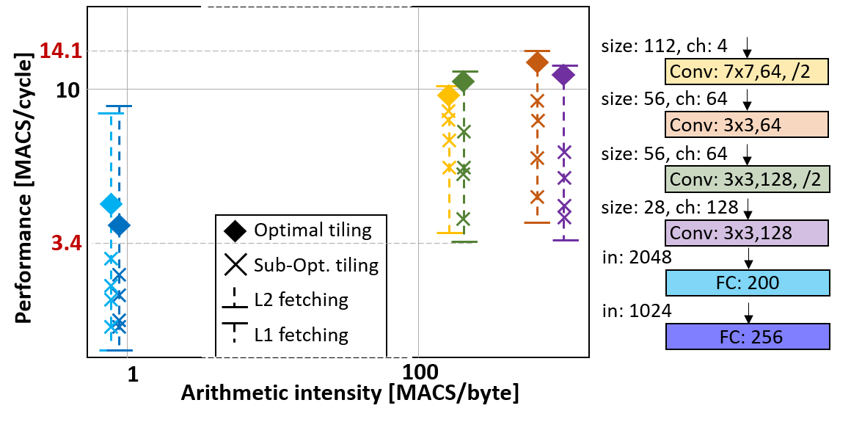
Dory: Deployment Oriented to memoRY
Optimal tiling found for PULP-NN backend.
Evolving towards graph optimization oriented to minimization of memory transfers
Less than 4% performance overhead when storing weights and activations in L2 with respect to direct L1 execution.
142 kB CNN for CIFAR10 inference.
 | Inf.time | Energy | MAC/cycle/core
L2 fetching | 22.7 ms | 0.97 mJ | 0.42 MAC
DORY | 7.1 ms | 0.51mJ | 1.37 MAC

